Slide 1



Report on OpenDaylight (ODL) Plug-in for Padtec ROADMs
University of Campinas – Unicamp
School of Electrical & Computer Engineering – FEEC
Alaelson Jatobá¹, Darli Mello¹, Christian Esteve Rothenberg², Dalton S. Arantes¹, Sergio Timóteo³
¹{alaelson,darli,dalton}@decom.fee.unicamp.br
²{chesteve}@dca.fee.unicamp.br
³{sergio}@padtec.com.br
December 01, 2014.

Slide 2
Goals
Maximize the wavelength utilization;
Reduces the blocking probability;
Assign appropriate routes and wavelengths over the lightpaths to maximize throughput;
Manage lightpath establishment in real-time;
Provisioning resources on demand (Manage connection request).

Slide 3
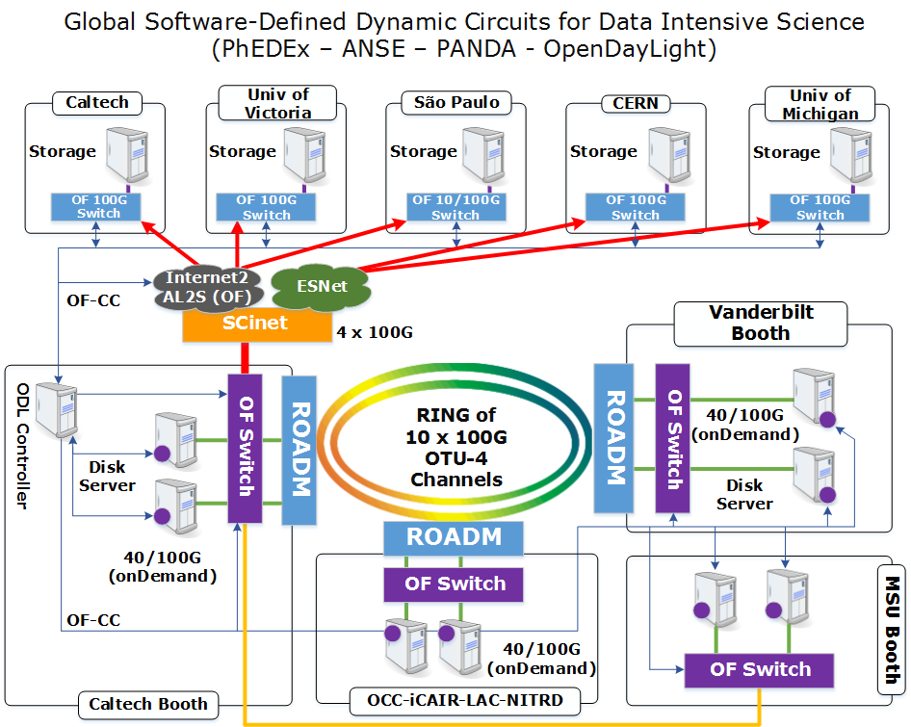
SC14 Complete overview

Slide 4
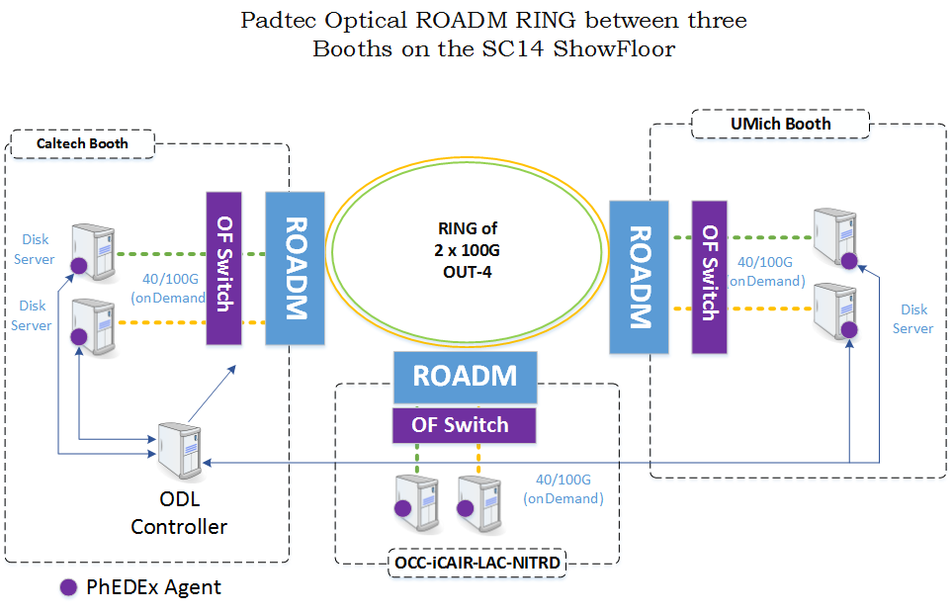
SC14 Complete overview

Slide 5
Network Interfaces used in the Showfloor
3 Booths in the showfloor:
Caltech: 10 x 100 Gbps
iCAIR: 6 x 100 Gbps
Vanderbilt: 4 x 100Gbps
Caltech booth has 2 switches
1 Brocade with 4 x 100Gbps
1 Extreme with 6 x 100Gbps

Slide 6
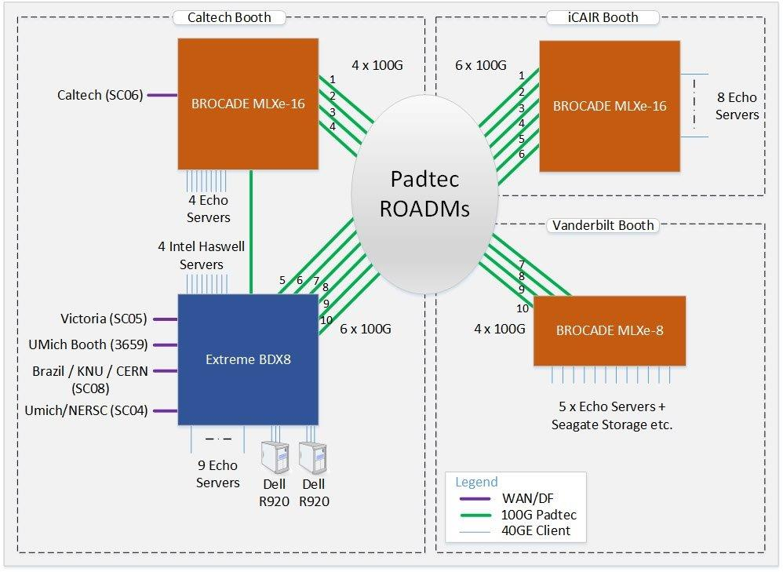
SC14 Demo Topology

Slide 7
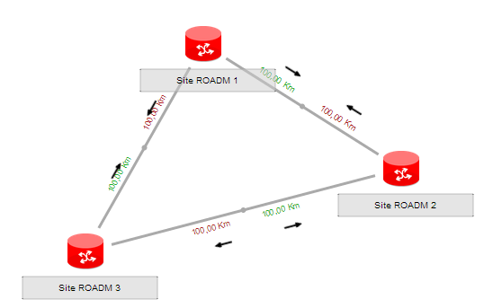
Padtec Directionless ROADM
10 Boards 100G OTU-4
C21 to C30
Direction C
Direction A
Direction B
Direction A
Direction C
4 Boards 100G OTU-4
C21 a C24
Direction B
Direction B
Direction C
10 Boards 100G OTU-4
C21 a C30
Direction A

Slide 8
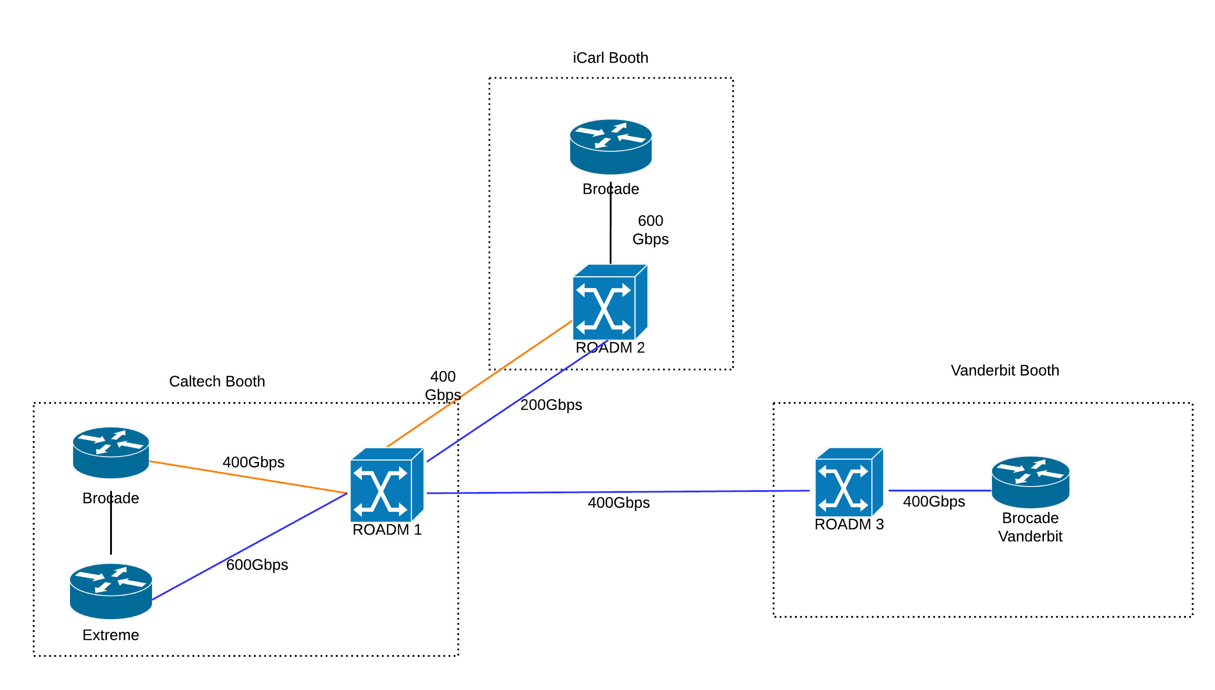
SC14 Demo Topology

Slide 9
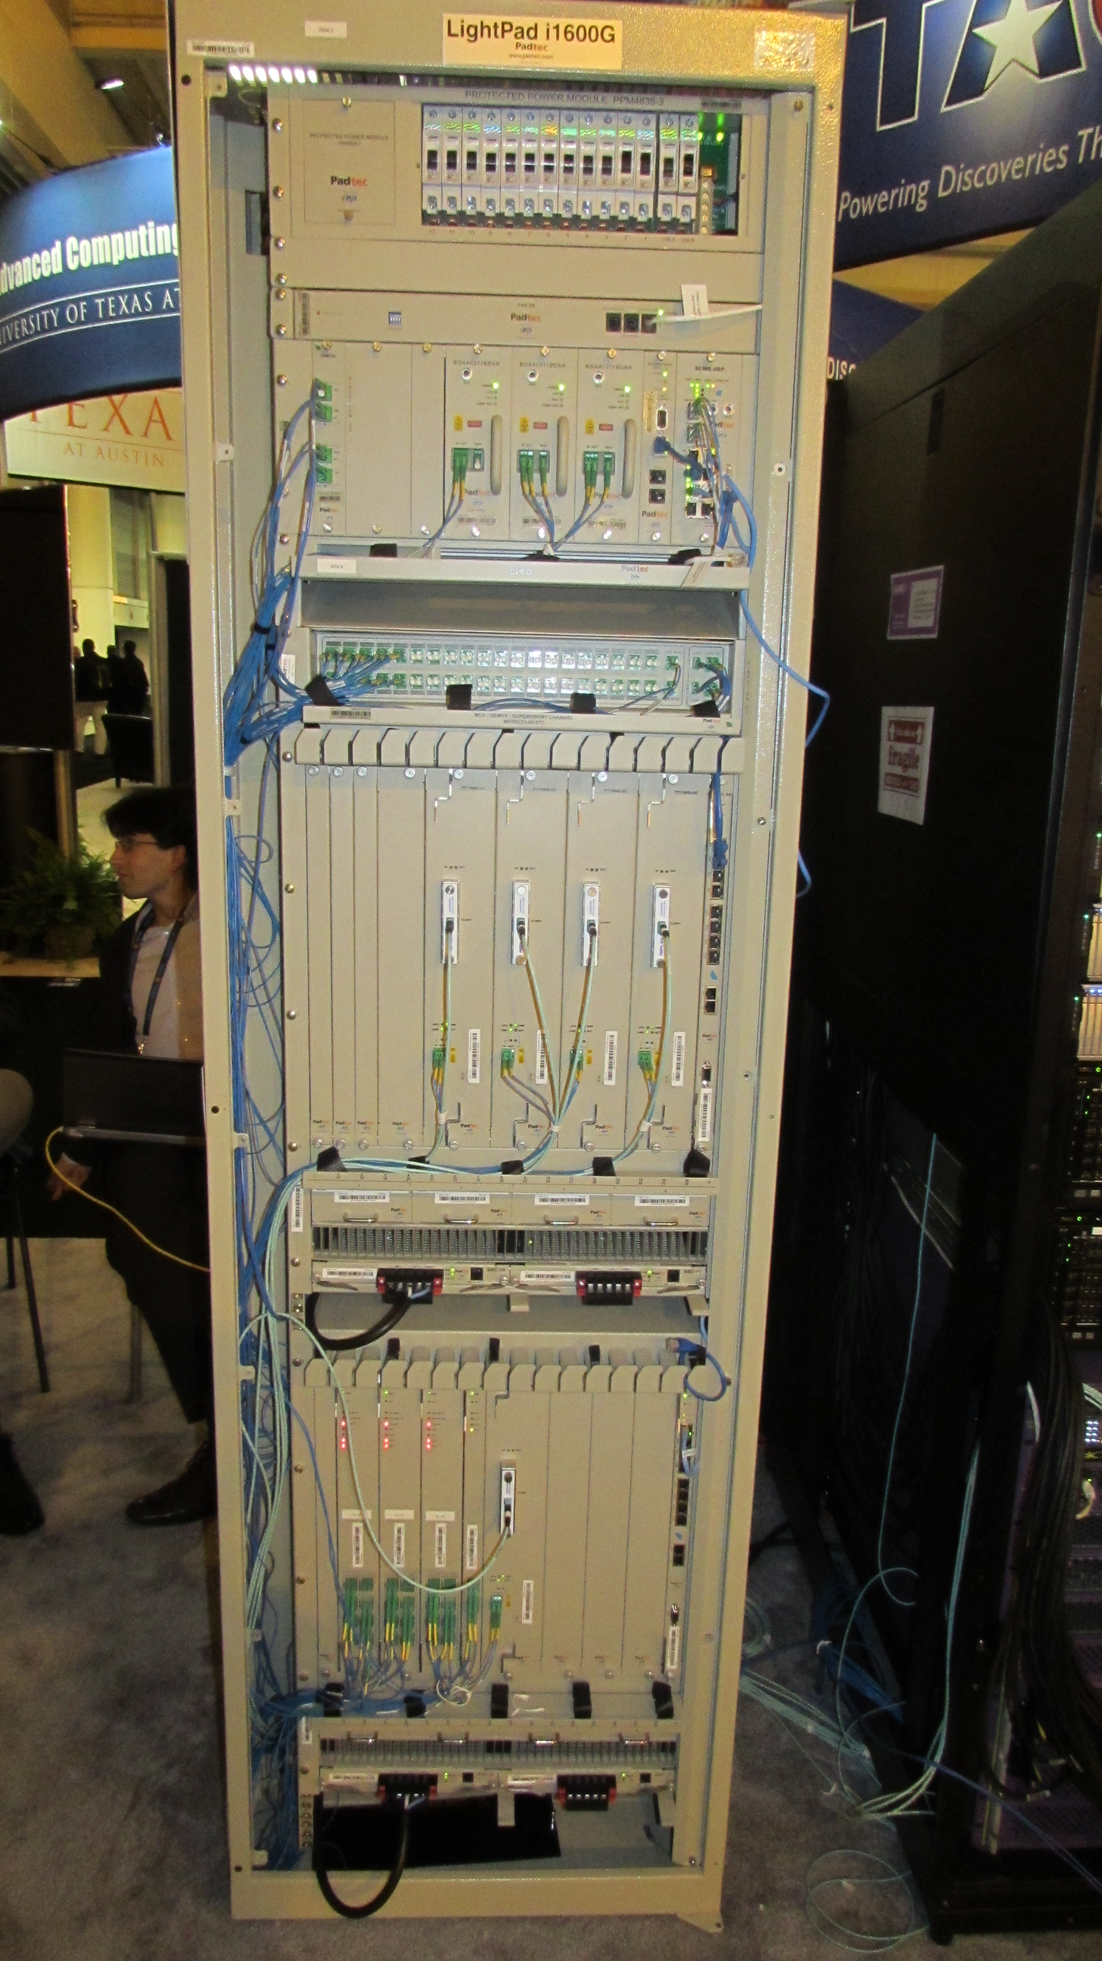
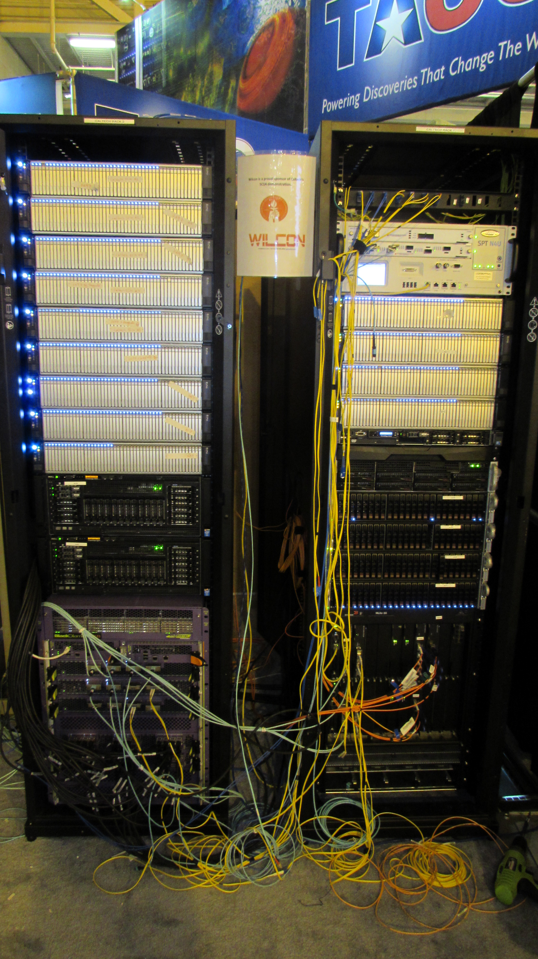
ROADM vs Routers
Padtec ROADM
Racks with EchoStream and Dell Servers, and
Extreme and Brocade Switches

Slide 10
100 Gb OTN-OTU4 vs 100 GbE
Extreme Switch with interfaces 100 GbE CFP2
Padtec Transponder

Slide 11
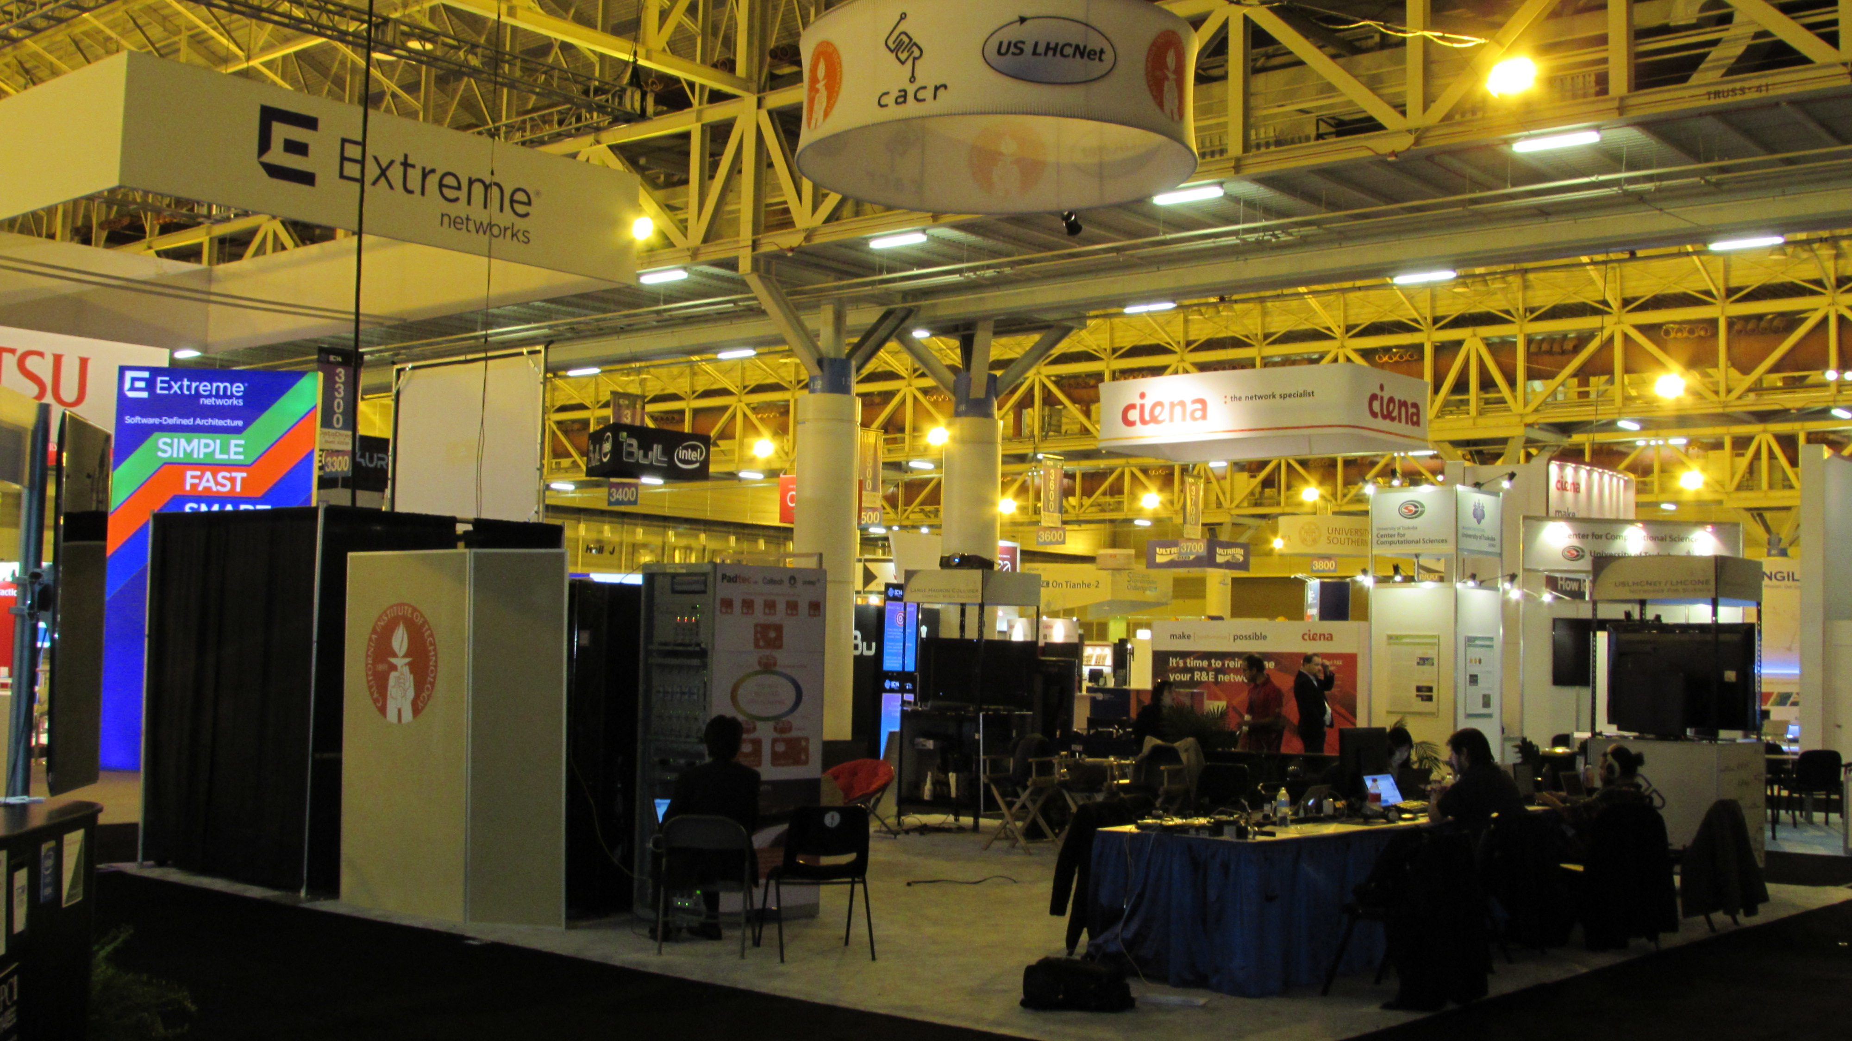
Pictures of the Caltech Booth
Padtec ROADM
Racks with EchoStream and Dell Servers, and
Extreme and Brocade Switches

Slide 12
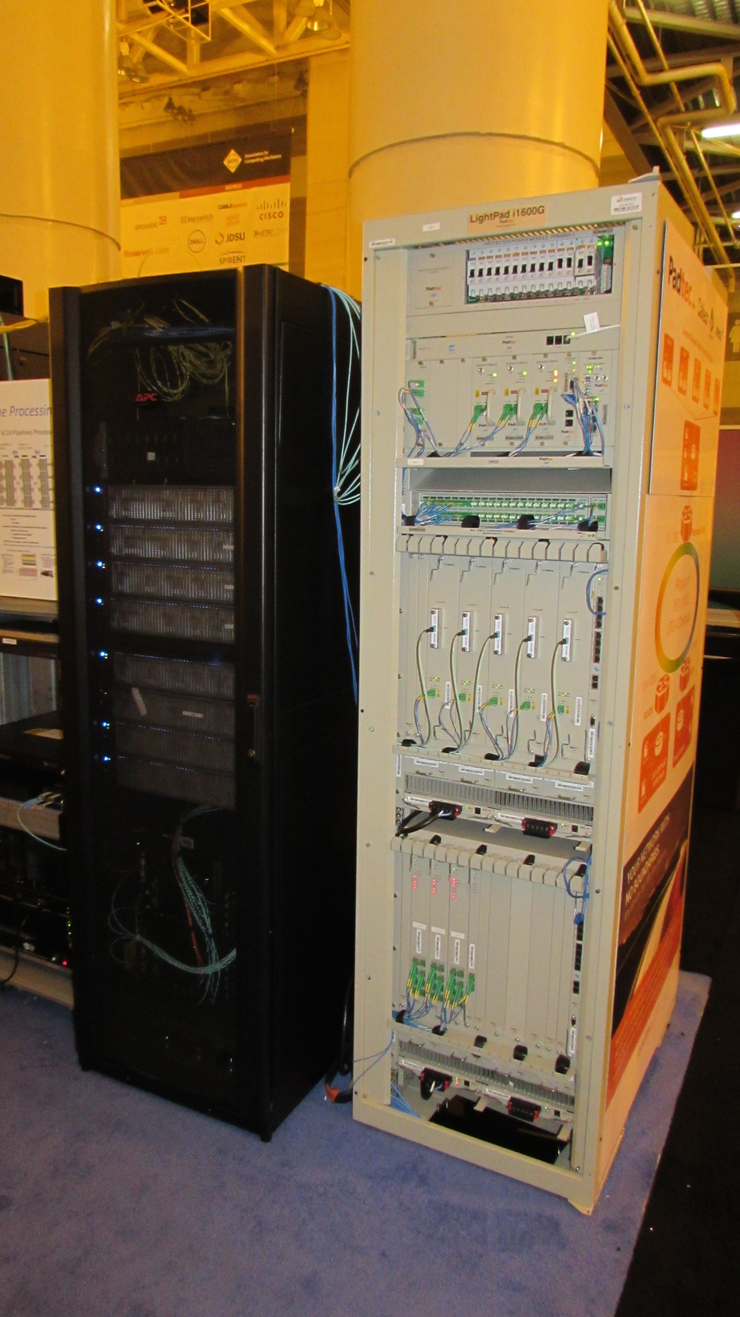
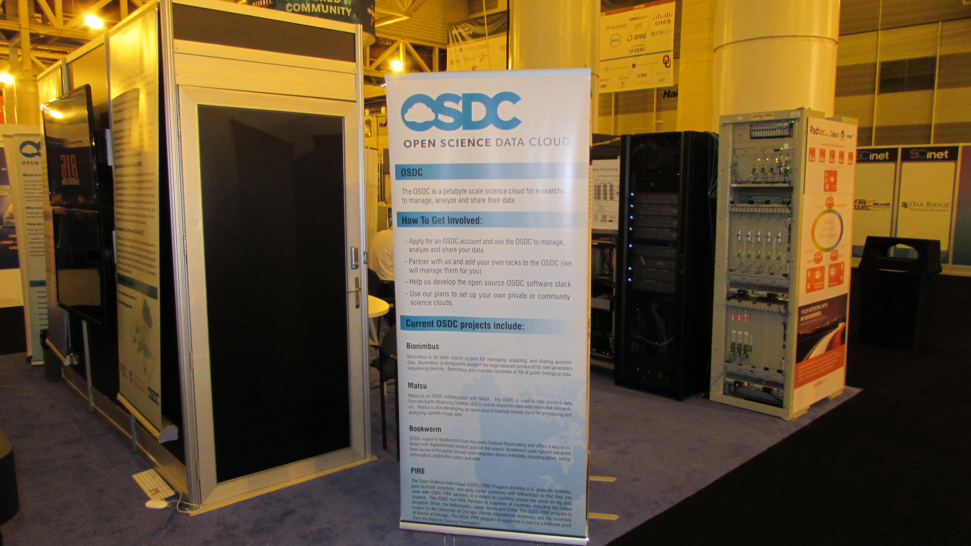
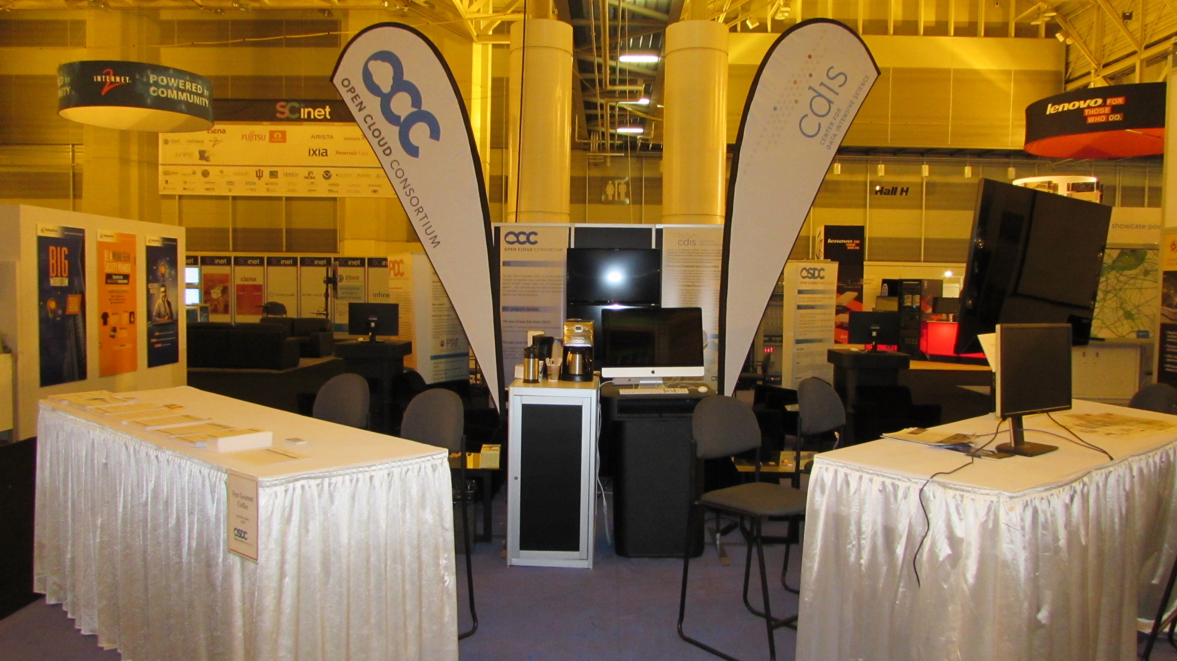
Pictures of the iCAIR Booth
Padtec ROADM
And Caltech’s Racks

Slide 13
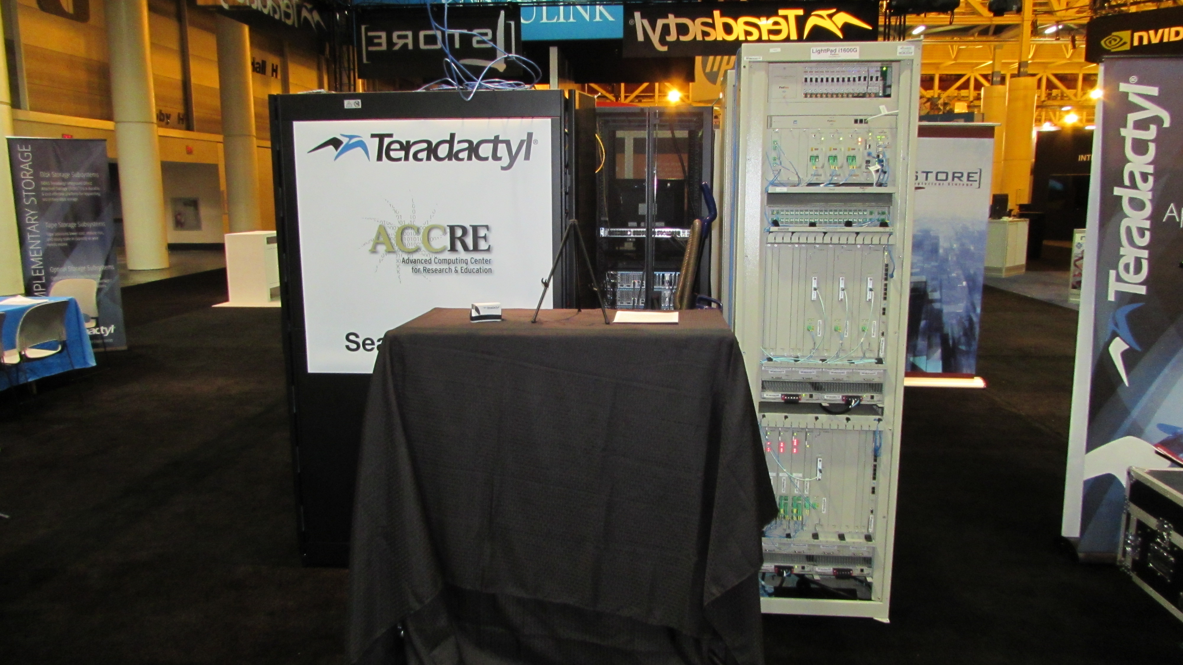
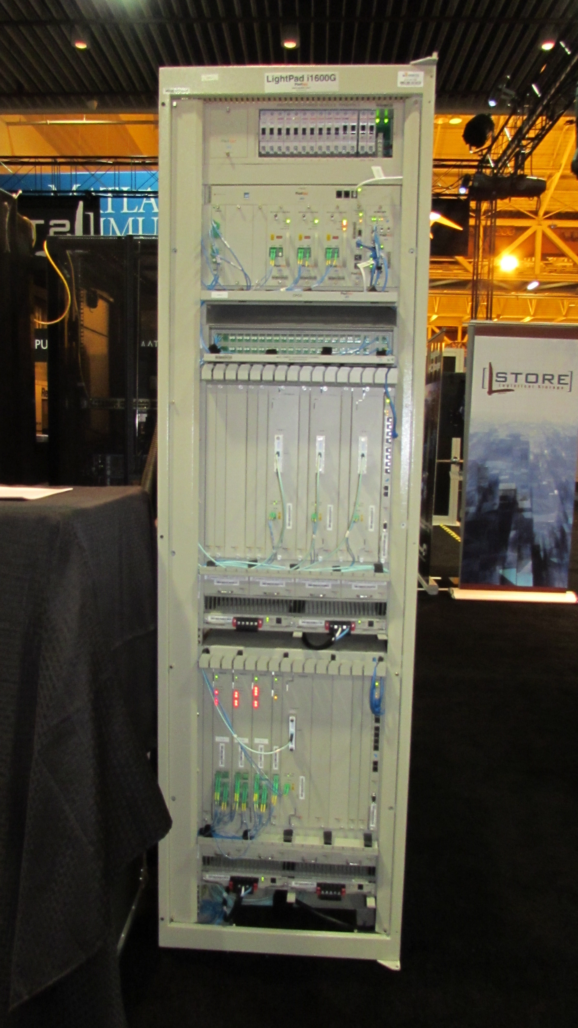
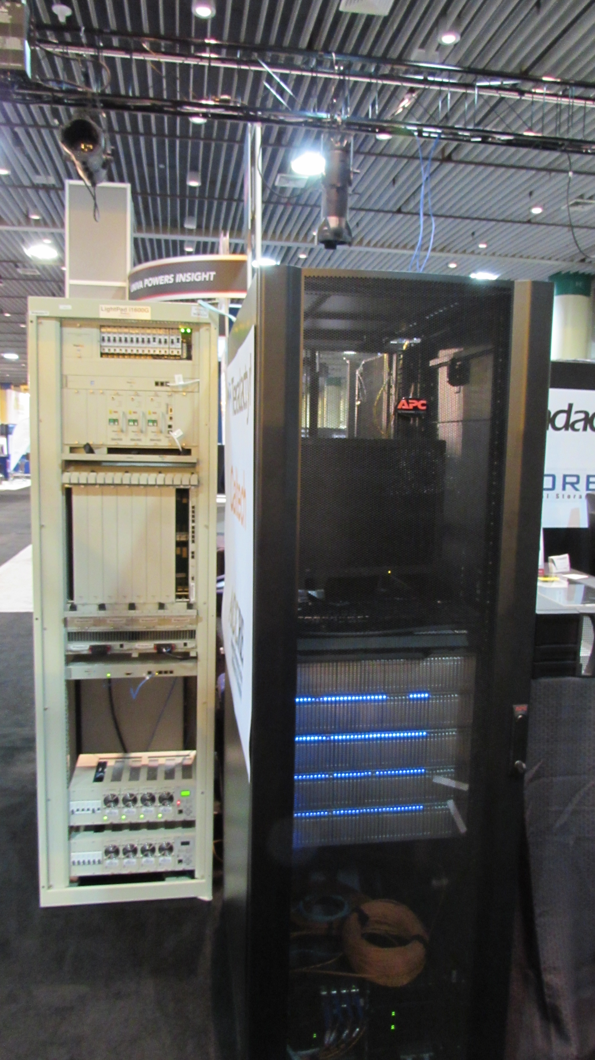
Pictures of the Vanderbilt Booth
Padtec ROADM

Slide 14
Results
sustained 1.4 Tbps during our memory to memory;
peak was 1.55 Tbps;
Disk to memory we reached a peak of 1.01 Tbps;

Slide 15
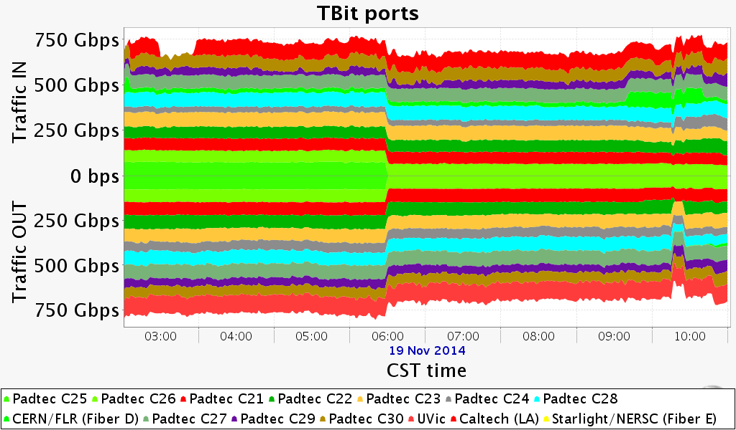
1.55 Tbps peak rate - memory to memory transfer

Slide 16
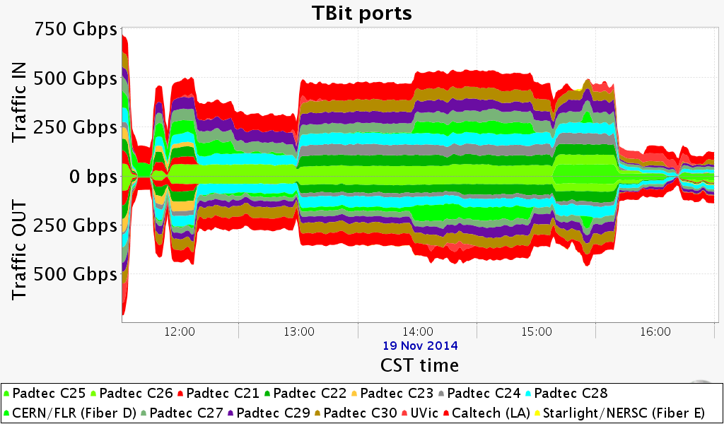
1 Tbps peak rate – disc to memory transfer

Slide 17

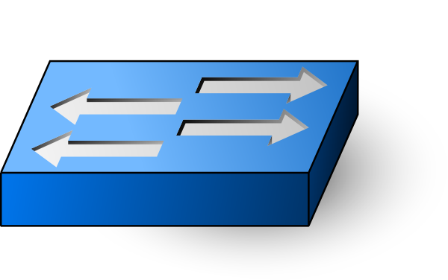
SDN System Architecture
Console Client
Caltech Fast Data Transfer
Rest
Rest
Rest
Orchestration
NB Caltech Plug-in
ODL NB Interface
SB Unicamp Plug-in
OpenFlow Support
Rest
OpenFlow
Switch
NB RESTful API
Padtec Mgmt Software
PADTEC ROADM
Padtec
Protocol

Slide 18
Client Application
FDT - Fast Data Transfer from Server to Storage System;
Lightpath management;
Preventive network diagnosis;
Reads and writes coordinated, streams or a large set of files with smooth data flow across long-range networks;
Science programs handling hundreds of petabytes per year

Slide 19
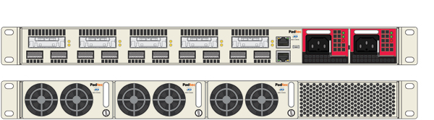
Thereafter: Terabit Padtec OTN Muxponder
1 Tbps from a 1RU chassis;
10 QSFP modules for the 100G client
5 coherent 200G CFP2
16QAM format to transmit 200G/wavelength)
This results in 2.5X the next highest marketed capacity.
1 RU
Fonte: http://www.lightwaveonline.com/articles/innovation-awards/padtec-terabit-otn-muxponder.html

